Slide 1

DATA Quality EDA DATA Wrangling
Discovery and Learning with Big Data/Data Discovery

Slide 2

Topics
Python Libraries
Data Quality
Data Quality Challenges
Dimensions of Data Quality
EDA
Data Wrangling

Slide 3

What is a Python Library?
A library is an umbrella term referring to a reusable chunk of code.
A Python library contains a collection of related modules and packages.
What is a package?
A package is a collection of modules.
Python library is used interchangeably with “Python package” because packages can also contain modules and other packages.
What is a module?
Real-world programs are complex, so developers leverage modular programming – a method of breaking large coding tasks into smaller and more manageable subtasks
The smaller subtasks group together to create a module.
A python module is related code saved in a file with the extension .py

Slide 4
What is a module?

Slide 5

Python Frameworks
Is a framework a library?
You may hear framework used interchangeably with python libraries.
More complex than a library
Frameworks contain the basic flow and architecture of the application.
A Python framework is a collection of modules and packages that help programmers to fast track the development process, examples:
Django
Flask
CherryPy
Bottle

Slide 6

Why do we care about Python Libraries?
Python has a large development community
Developers create Python libraries to share reusable code with the community.
To eliminate the need for writing code from scratch, they create a set of useful functions related to the same area.

Slide 7
Popular Libraries
Pandas
NumPy
Scikit-Learn
TensorFlow
Keras
SciPy
Statsmodels
Plotly
Seaborn

Slide 8

Pandas
Python library for data wrangling and analysis.
Built around a data structure called the DataFrame.
A pandas DataFrame is a table, similar to an Excel spreadsheet.
Provide a great range of methods to modify and operate on this table
Written by Wes McKinney
Easy handling of missing data
Powerful group by function
Good for merging, joining, reshaping, and pivoting data sets

Slide 9
Pandas
Pandas library is preinstalled on Anaconda
conda install pandas or pip install pandas
You can load it manually from github
https://github.com/pandas-dev/pandas
Import command:
import pandas as pd
Pandas cheat sheet https://pandas.pydata.org/Pandas_Cheat_Sheet.pdf

Slide 10

Numpy
NumPy can be used to perform a wide variety of mathematical operations on arrays.
It adds powerful data structures to Python that guarantee efficient calculations with arrays and matrices and it supplies an enormous library of high-level mathematical functions.
Using NumPy, a developer can perform:
Mathematical and logical operations on arrays.
Fourier transforms and routines for shape manipulation.
Operations related to linear algebra.
NumPy has built-in functions for linear algebra and random number generation.

Slide 11

scikit-learn
Easy to use and efficient tools for machine learning and statistical modeling
Open source
Provides a range of supervised and unsupervised learning algorithms
Built upon NumPy, SciPy, and Matplotlib.
Developed in 2007 by David Cournapea
Also known as sklearn
Library preinstalled on Anaconda
You can load it manually from github
https://github.com/scikit-learn/scikit-learn
Importing packages or modules from scikit learn
from sklearn import svm (support vector classification)
from sklearn import tree (Decision trees)

Slide 12
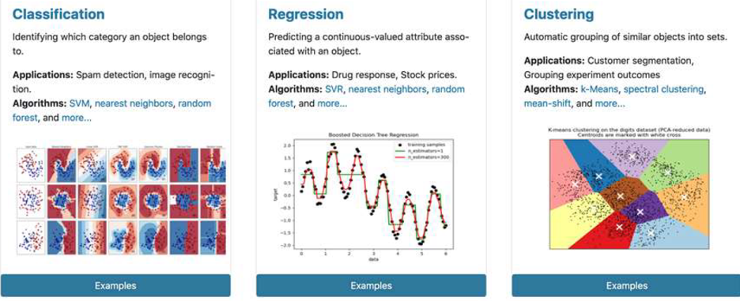
scikit-learn
Classification
Regression
Clustering
Dimensionality Reduction
Model selection
Preprocessing
Feature extraction
Feature selection

Slide 13

SciPy
Includes fundamental algorithms, see scipy.org
SciPy provides algorithms for optimization, integration, interpolation, eigenvalue problems, algebraic equations, differential equations, statistics and many other classes of problems.
Foundational to scikit-learn and NumPy
Open-source
Easy to use
Developed by Eric Jones, Pearu Peterson, and Travis Oliphant in 2001

Slide 14

Statsmodels
Provides classes and functions for estimating statistical models
Good for conducting statistical tests
Excellent for statistical data exploration
From https://www.statsmodels.org/stable/index.html
“statsmodels is a Python module that provides classes and functions for the estimation of many different statistical models, as well as for conducting statistical tests, and statistical data exploration.”

Slide 15
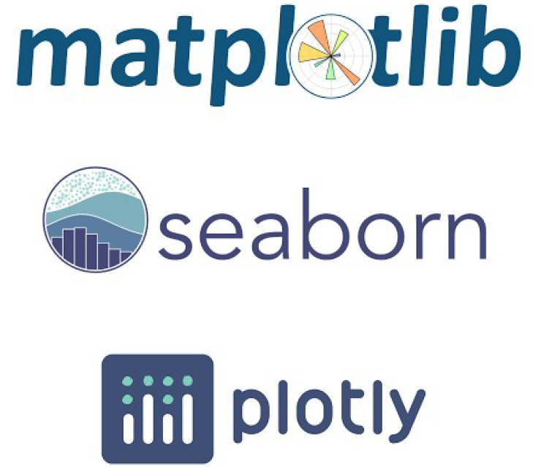
Data Visualization Libraries
Matplotlib
Seaborn
Plotly

Slide 16

matplotlib
Creates quality plots
Makes interactive figures
Allows for customization
Embed in JupyterLab and most GUIs
Foundation for many other packages
Developed in 2003 by Michael Droettboom
import matplotlib.pyplot as plt

Slide 17

Seaborn
Python data visualization library based on matplotlib
High-level interface for specialized statistical graphics
import seaborn as sns

Slide 18

plotly
The plotly Python library is an interactive, open-source plotting library that supports over 40 unique chart types covering a wide range of statistical, financial, geographic, scientific, and 3-dimensional use-cases.
Open-source
Graphing libraries are free to use
Commercial offerings
Dash Enterprise
Chart Studio Enterprise
conda install plotly
import plotly.express as px

Slide 19
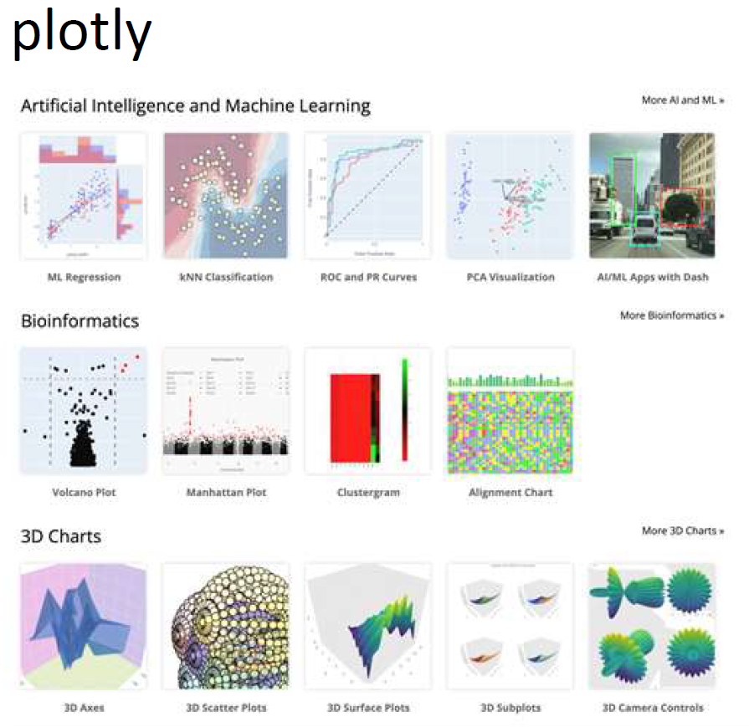

Slide 20

Starting a project or experiment
import pandas as pd
import numpy as np
import seaborn as sns
import matplotlib.pyplot as plt
import plotly.express as px

Slide 21
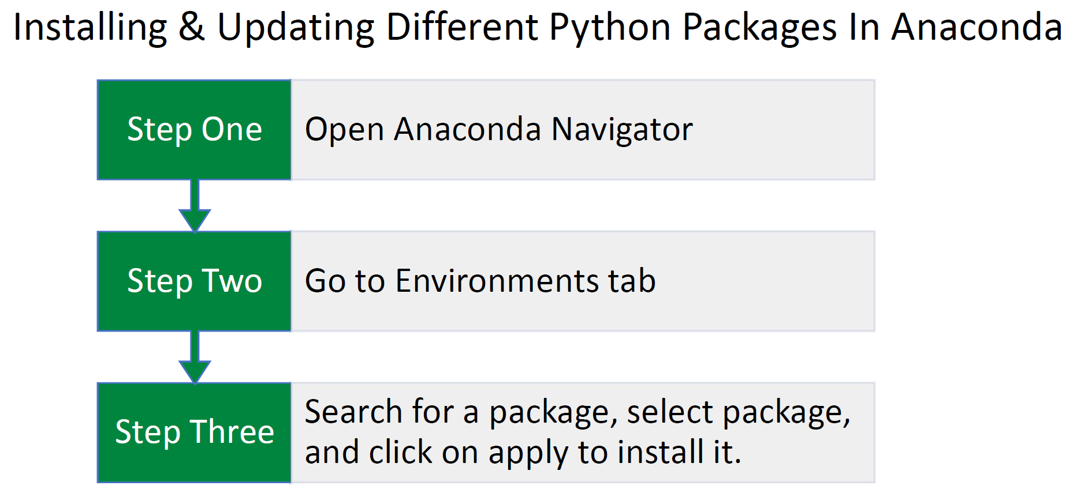
Installing Python Libraries on Anaconda

Slide 22
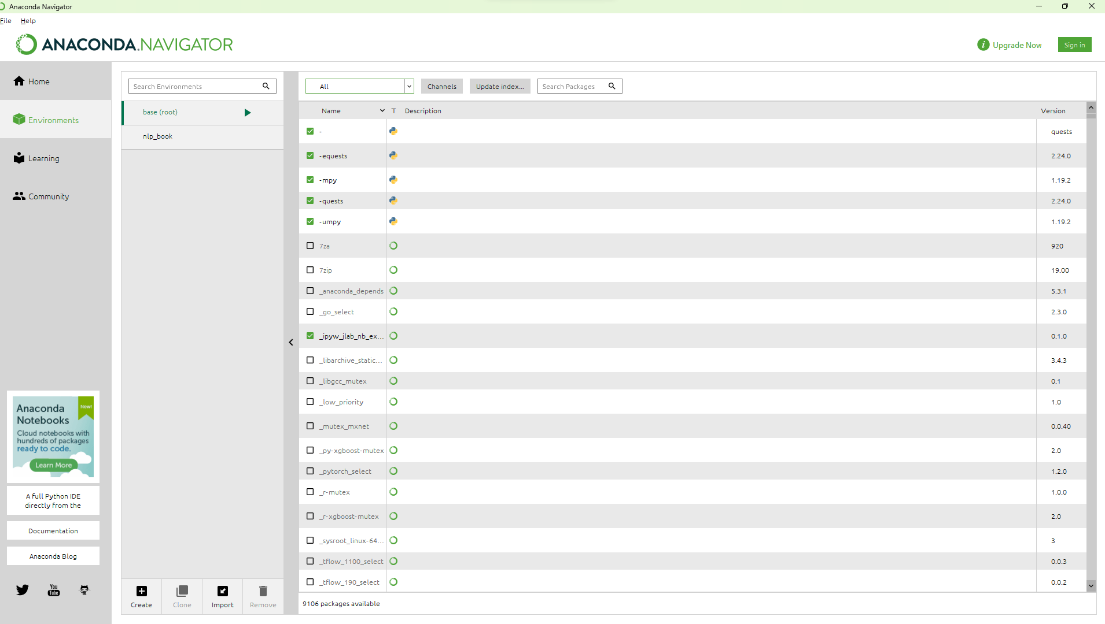

Slide 23
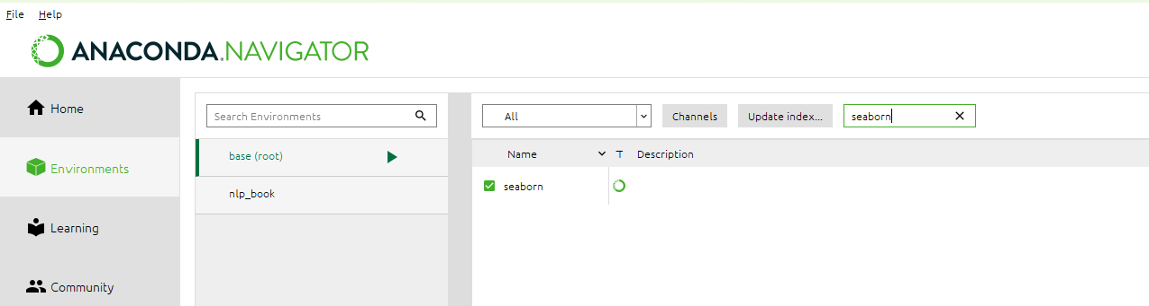
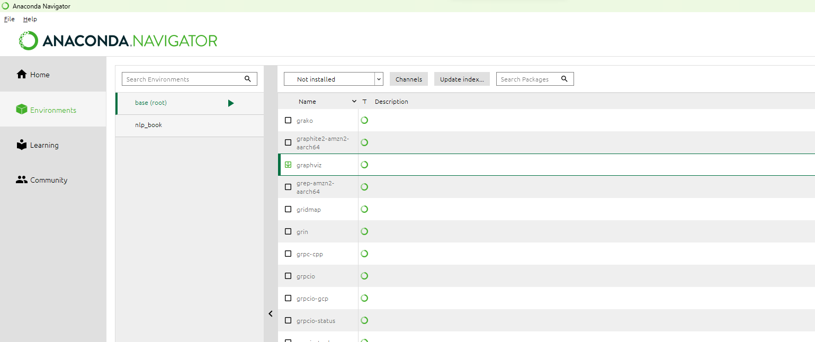

Slide 24
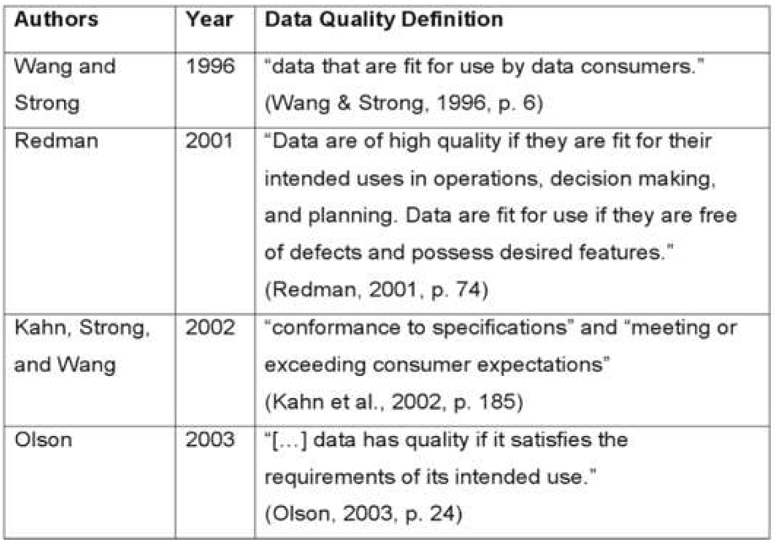
Data Quality?
Measures of data quality are based on data quality characteristics, referred to as the dimensions of data quality.
Six/seven/ten/twelve dimensions of data quality

Slide 25
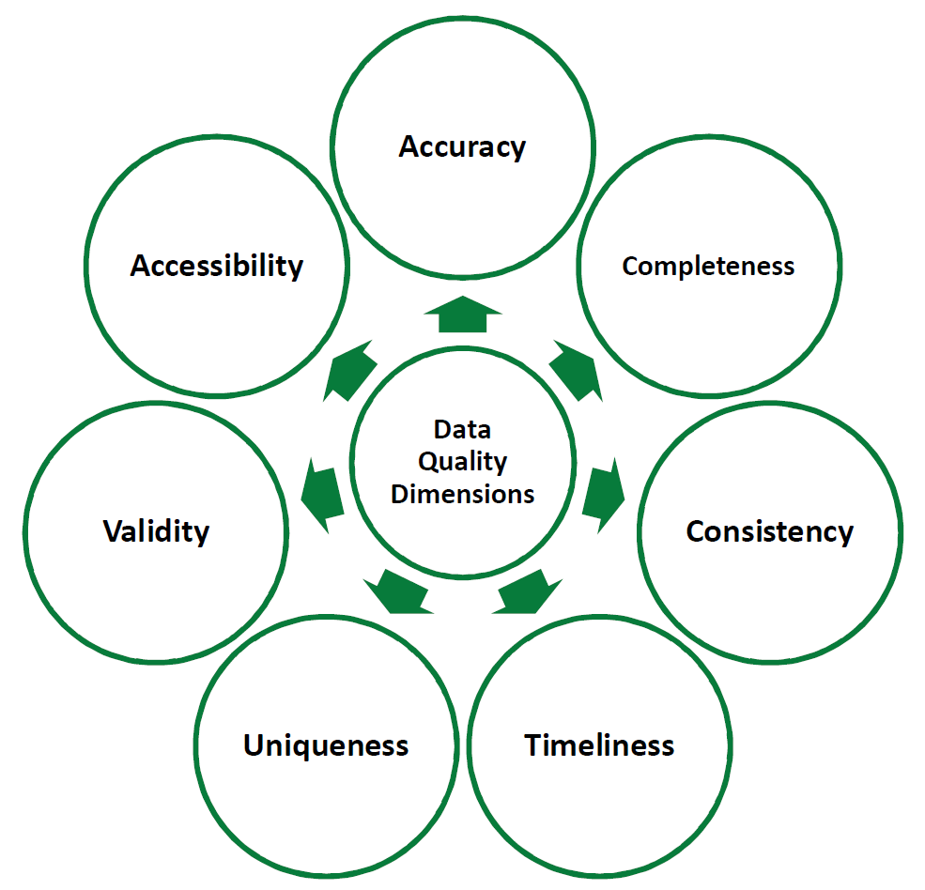
Dimensions of Data Quality

Slide 26

Why is Data Quality Important?
Bad Data creates a problem for everyone
The cost of bad data is 15% to 25% of revenue for most companies. –HBR
Knowledge workers waste up to 50% of their time dealing with mundane data quality issues.
Data scientists waste up to 80% of their time dealing with mundane data quality issues.
The yearly cost of poor-quality data, in the US alone, in 2016 was $3.1 trillion. –IBM
Remember garbage in, garbage out.

Slide 27

EDA
Exploratory Data Analysis (EDA) is an approach/philosophy for data analysis that employs various techniques (mostly graphical).
Exploratory Data Analysis (EDA) techniques
Often the first step in data analysis
It's like asking data to tell you something you don't already know
It gives the researcher a bird's eye view of the data
Maximize insight into a data set
Uncovers underlying structure
Extract important variables
Detect outliers and anomalies
Test underlying assumptions
Develops models and determine optimal factor settings

Slide 28

EDA
EDA is a philosophy in providing an approach to data without assumptions
It can help identify any obvious errors
Better understand patterns
Better understand variables and their relationships
Detect abnormal events
Ensure the results are valid and applicable to the outcomes and goals of the project
Allows the analyst to get a "feel" for the data
Empowers you to ask the right questions

Slide 29

EDA
Many EDA techniques are graphical
Graphical examples:
Plotting raw data such as histograms and probability plots
Plotting simple statistics, such as mean plots, standard deviation plots, and box plots
Positioning such plots to maximize our natural pattern-recognition abilities
Graphical examples:
Histograms
Stem and Leaf plots
Boxplots
Quantile normal
Bar plots
Side-by-side boxplots
Scatterplot

Slide 30
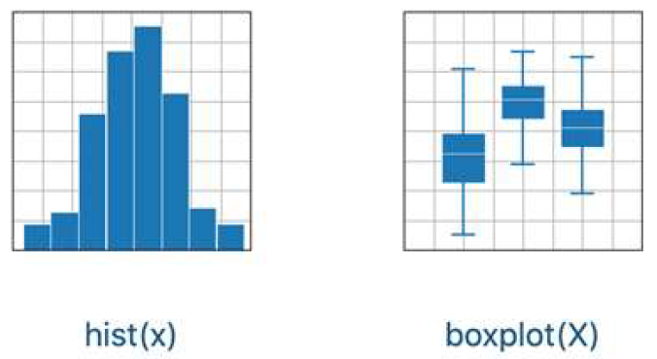
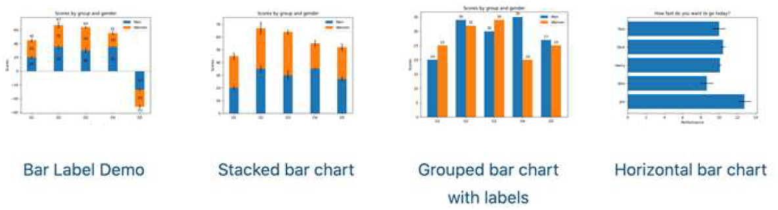

Slide 31
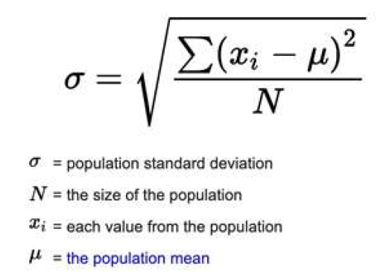
EDA
Non-graphical examples:
Sample distribution
Center
Spread Variance
Standard deviation
Interquartile range
ANOVA
Central tendency (mean, mode, median)
Range
Frequency

Slide 32

EDA Types
Univariate (One Variable)
Univariate non-graphical
Univariate graphical
Multivariate (Multiple Variables)
Multivariate non-graphical
Multivariate graphical

Slide 33


EDA
Python Libraries: Pandas
Pandas is quite a game-changer when it comes to analyzing data with Python
Works with many data sources (CSV or TSV file, SQL database, etc.) and creates a Python object with rows and columns.
Python Libraries: Matplotlib
It is a 2D Plotting Library
You can create:
Plots
Histograms
Bar Charts
Scatterplots, etc.

Slide 34

Data Wrangling
Data wrangling is the process of preparing source data for efficient and accurate analysis.
Data wrangling is sometimes called data munging or data preparation.
Data-wrangling activities include
removing missing values,
formatting features uniformly, and
appending related data from external sources.
Notes:
https://learn.zybooks.com/zybook/UNTADTA5340OrhanFall2023/chapter/5

Slide 35
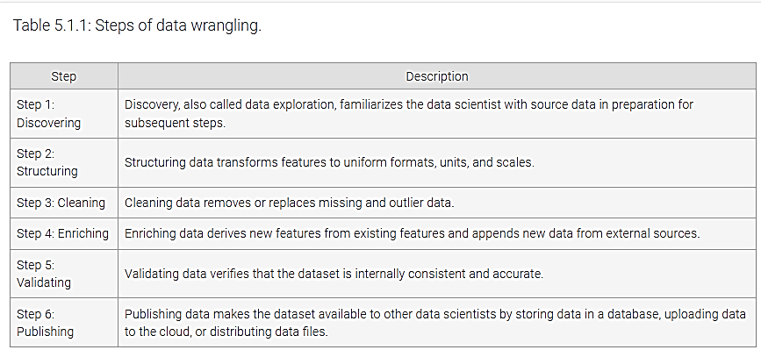
Notes:
https://learn.zybooks.com/zybook/UNTADTA5340OrhanFall2023/chapter/5

Slide 36

Discover then handle the problems
What do I have in my data?
Types,
features,
missing values,
outliers,
noise,
typo,
units,
etc.

Slide 37

Extract, Transform, Load(ETL)
Extract, Transform, Load (ETL) is a process that
extracts data from transactional databases,
transforms the data, and
loads the data into an analytic database.
ETL transforms data in a staging area, such as a temporary database, prior to loading data to the analytic database.
Extract, Load, Transform (ELT) is a variant of ETL that loads raw data directly to the analytic database and transforms the data in place.
Notes:
https://learn.zybooks.com/zybook/UNTADTA5340OrhanFall2023/chapter/5

Slide 38

Extract, Transform, Load(ETL)
ETL vs. data wrangling.
Similar: Structure, clean, enrich, and publish data.
Different:
Data wrangling is usually an informal process, executed manually by data scientists on a static dataset.
ETL is an automated process that repeatedly extracts new data from transactional databases. ETL is usually applied to larger data volumes and more sources than data wrangling.
ETL tools, also called data integration tools, extract and merge data from many different database systems.
ETL tools can be used for data wrangling, but usually preferred tools are spreadsheets or programming languages such as Python, R, and SQL.
Notes:
https://learn.zybooks.com/zybook/UNTADTA5340OrhanFall2023/chapter/5

Slide 39
Python DataFrames
pandas for data wrangling.
DataFrame is a pandas class that stores and manipulates datasets.
Dataframes consist of rows and columns, representing dataset instances and features.
Each column has a data type.
Rows and columns are identified by integer or string labels.
The set of row labels is called the index
The set of column labels is called columns.
Usually, row labels are automatically generated integers and column labels are manually specified strings.

Slide 40
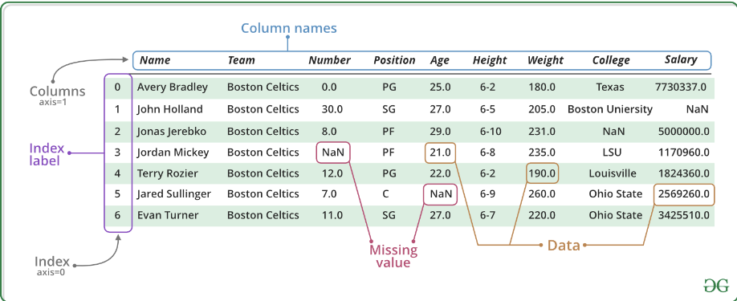

Slide 41
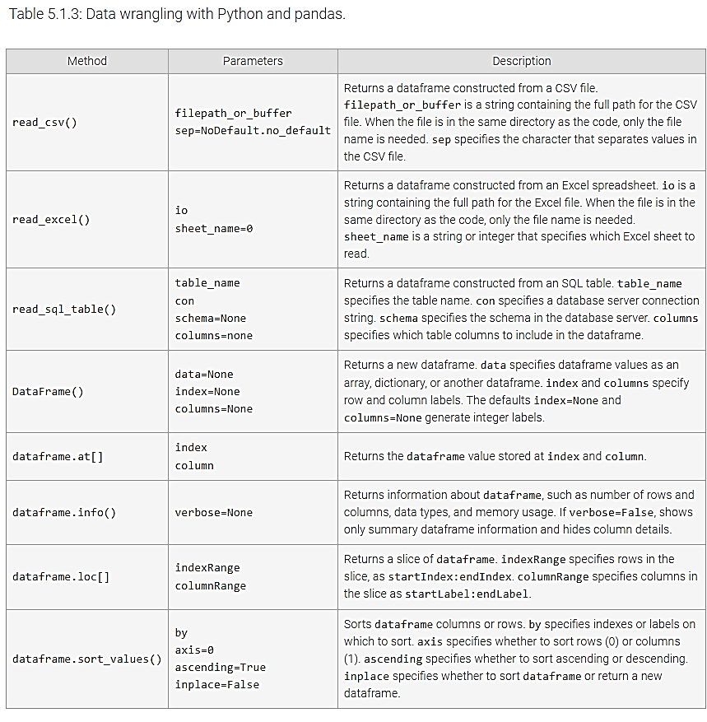
Notes:
https://learn.zybooks.com/zybook/UNTADTA5340OrhanFall2023/chapter/5

Slide 42
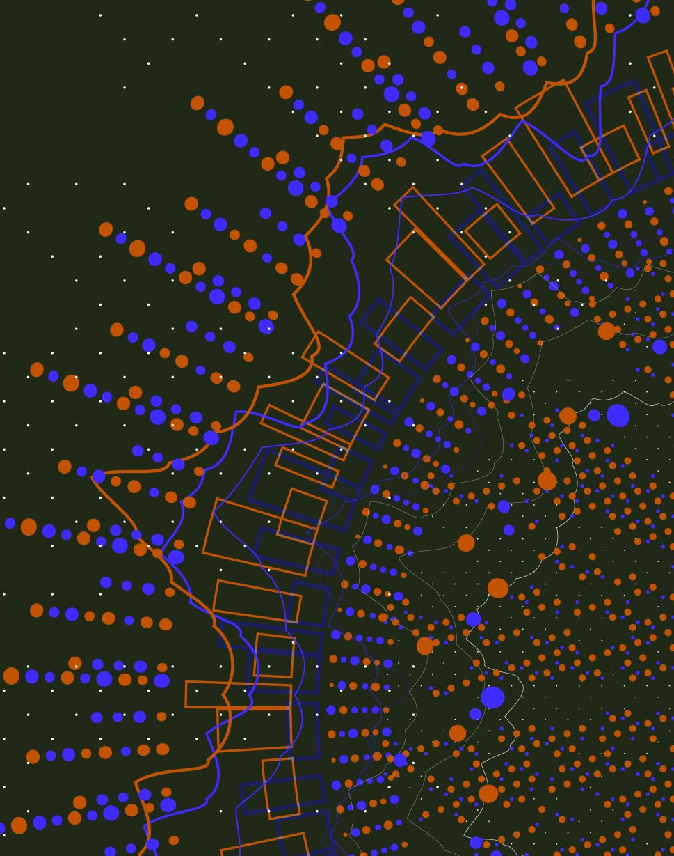
Data Manipulation
First data discovery:
Exploring patterns and trends within a dataset
visually through plots or figures, or
numerically by comparing descriptive statistics.
organize or subset a dataset
split datasets into multiple groups based on a categorical feature,
or compare values of a dataset according to a specific condition.
Then use descriptive statistics like the mean, median, or proportion can be calculated and compared across groups or conditions.

Slide 43
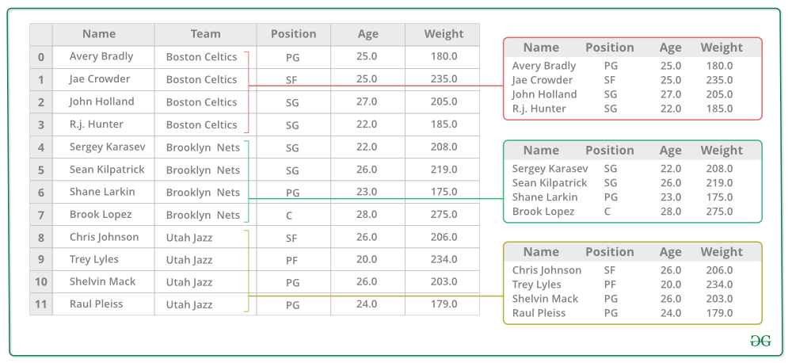
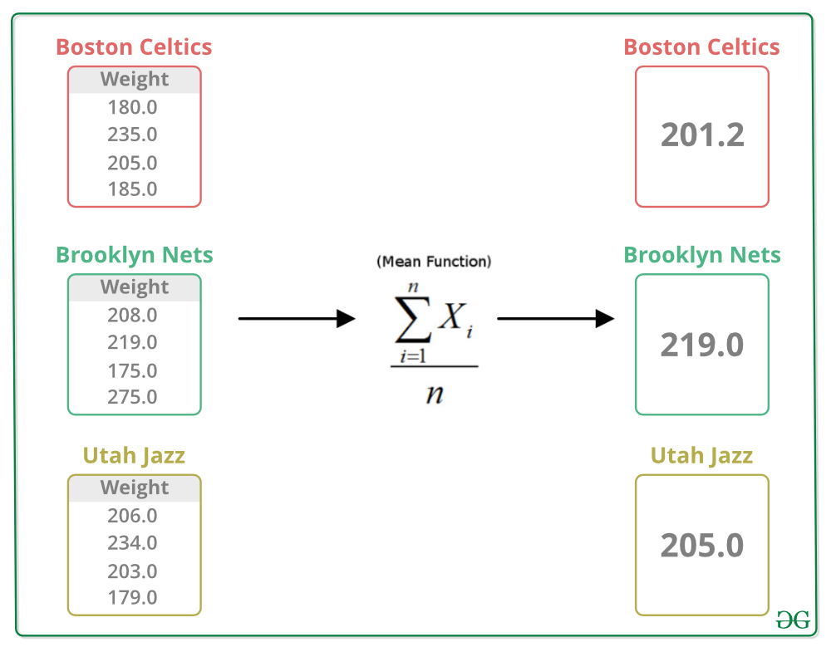
Notes:
https://www.geeksforgeeks.org/pandas-groupby/

Slide 44
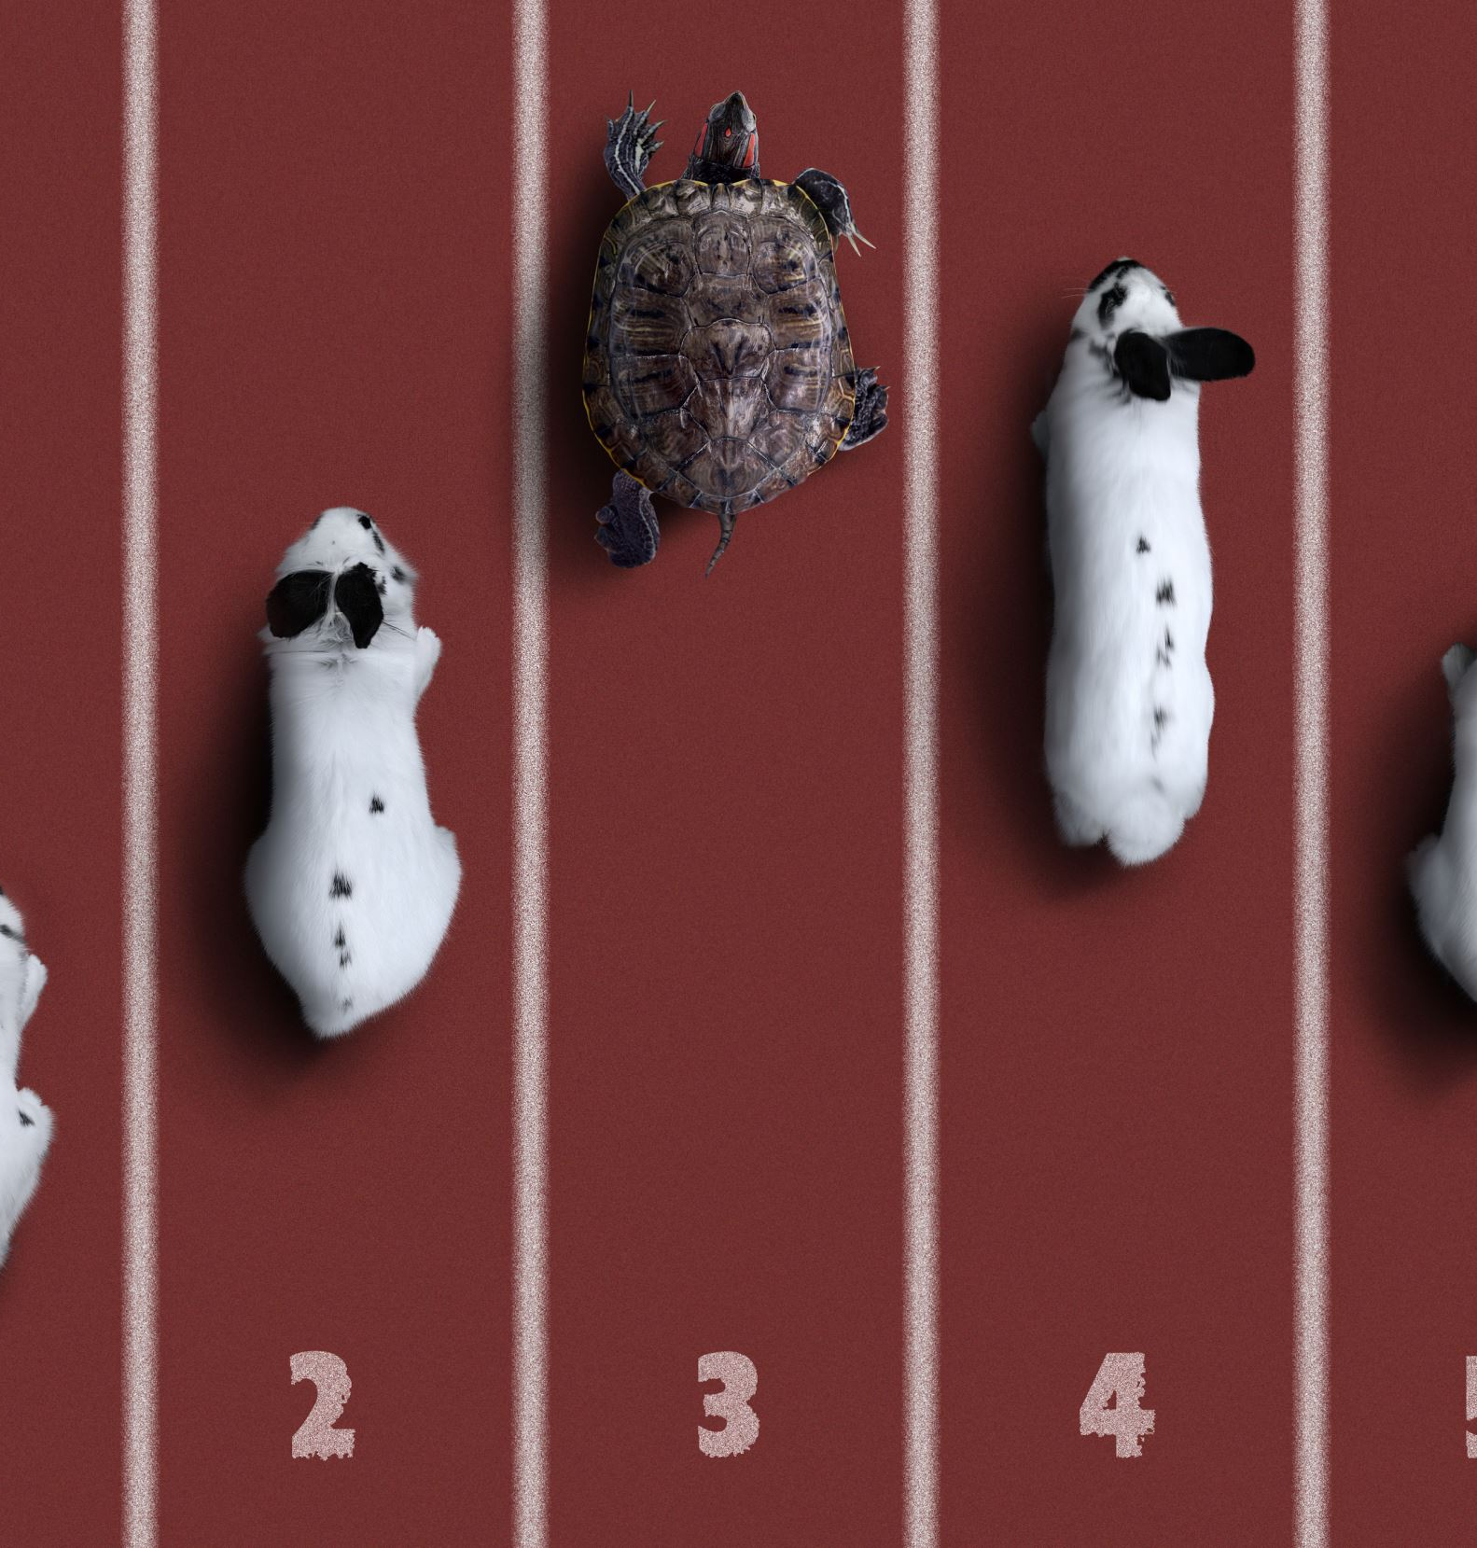
Grouping
Grouping is used to separate a data frame into subsets based on levels of a categorical feature.
Different analysis or model may be applied to each group.
Calculate group sizes or descriptive statistics like group means.
A frequency table is a table containing group sizes for a categorical feature.
Notes:
https://learn.zybooks.com/zybook/UNTADTA5340OrhanFall2023/chapter/5/

Slide 45
Pivot Tables
pivot table: A pivot table calculates and displays descriptive statistics after grouping based on values of two categorical features.
contingency table: A contingency table is a special case of a pivot table in which the descriptive statistic is the number of instances in each combination of categorical features.
Notes:
https://learn.zybooks.com/zybook/UNTADTA5340OrhanFall2023/chapter/5/

Slide 46
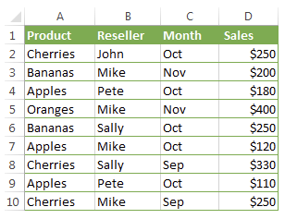
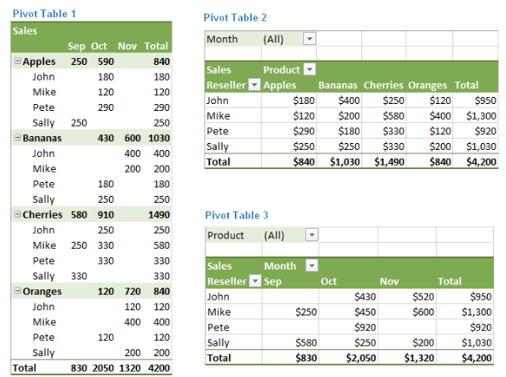
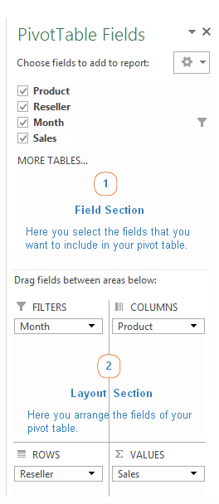
Notes:
https://www.ablebits.com/office-addins-blog/excel-pivot-table-tutorial/

Slide 47
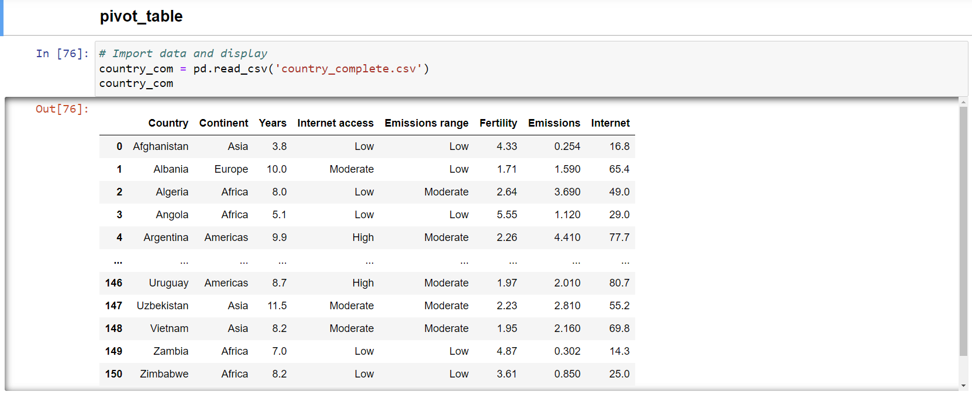
Python pivot table

Slide 48
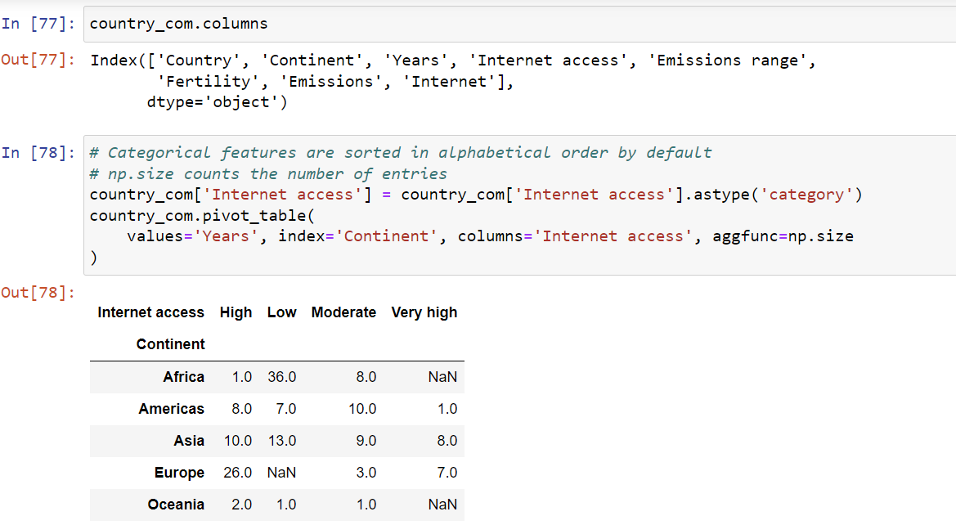
Python pivot table

Slide 49
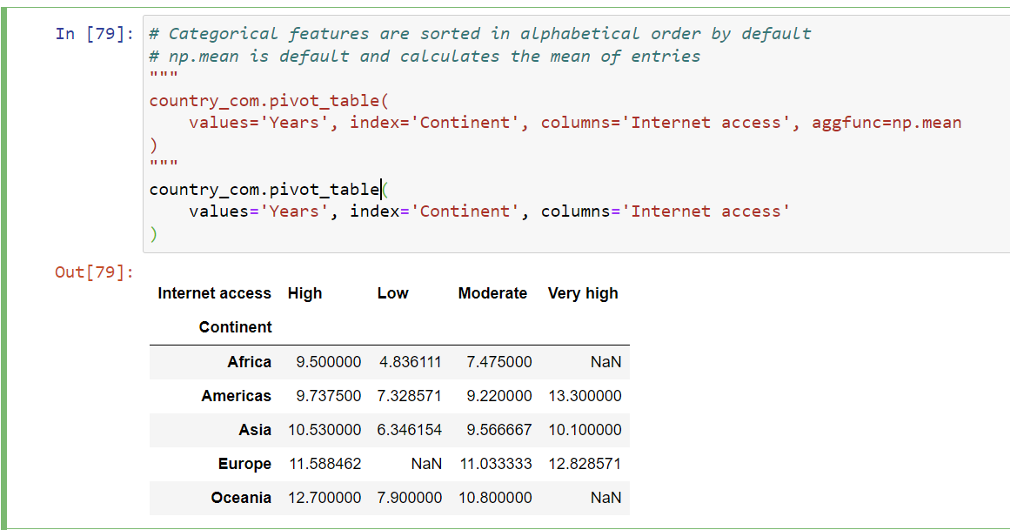
Python pivot table

Slide 50
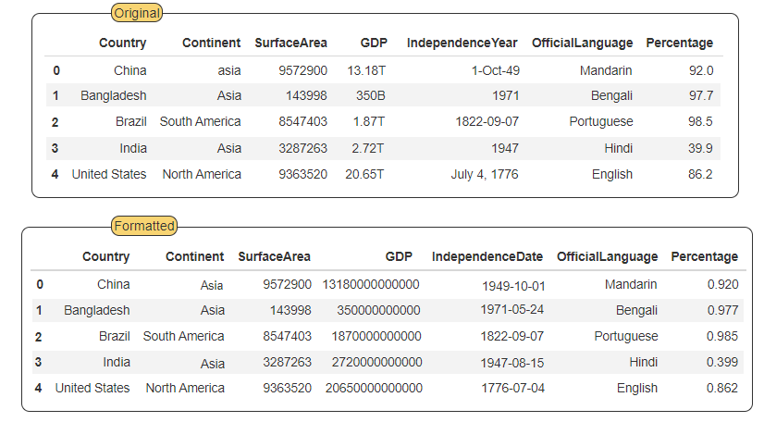
Structuring Data
Formatting data: All data within a single column and similar data in multiple columns should be stored in a uniform format.
Notes:
https://learn.zybooks.com/zybook/UNTADTA5340OrhanFall2023/chapter/5

Slide 51
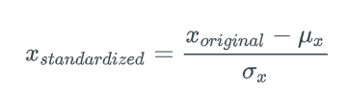
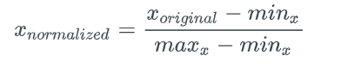
Feature Scaling
Standardization / z-score: Standardization converts features to a range centered at 0, with 1 representing a standard deviation. The standardized value is called a z-score.
Normalization: Normalization converts features to the range [0,1]:

Slide 52
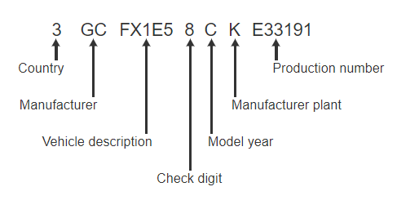
Feature extraction
Overloaded feature: An overloaded feature encodes multiple types of data.
Simple feature: A simple feature contains only one type of data.
Example: VIN
Notes:
https://learn.zybooks.com/zybook/UNTADTA5340OrhanFall2023/chapter/5/

Slide 53
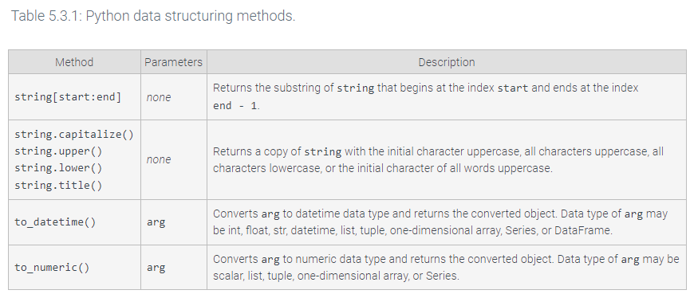
Structuring
Notes:
https://learn.zybooks.com/zybook/UNTADTA5340OrhanFall2023/chapter/5/

Slide 54
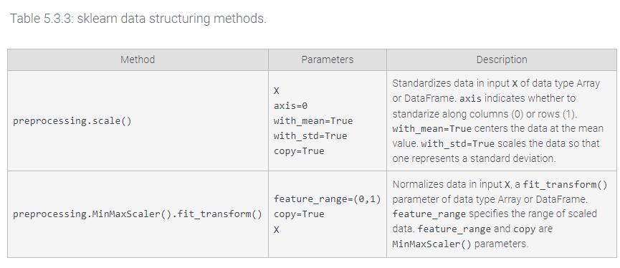
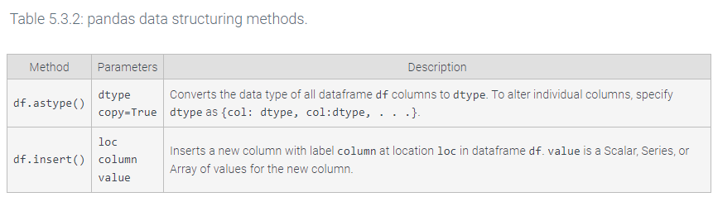
Structuring
Notes:
https://learn.zybooks.com/zybook/UNTADTA5340OrhanFall2023/chapter/5/

Slide 55
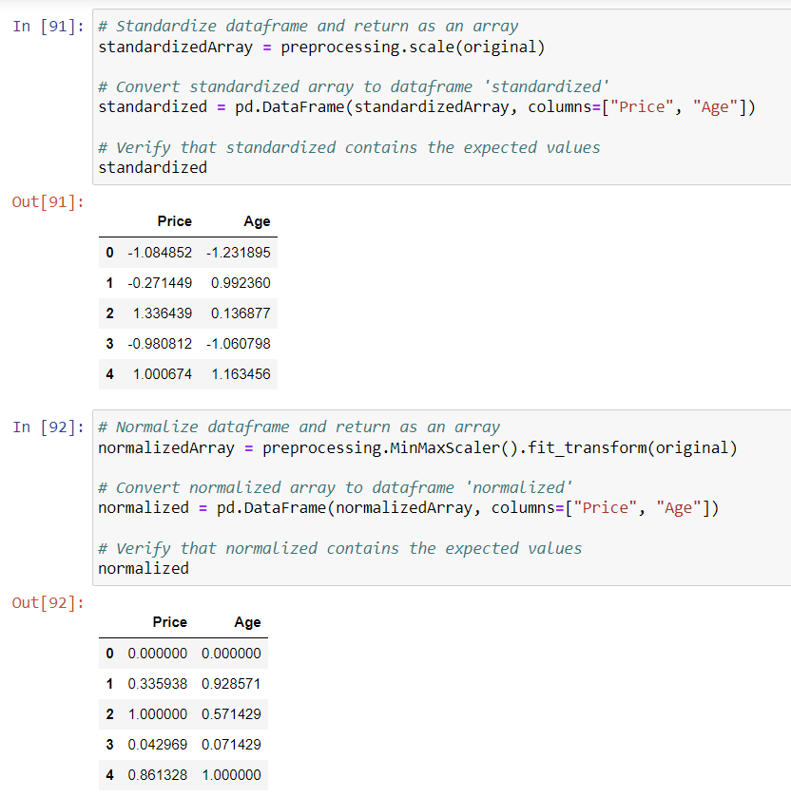
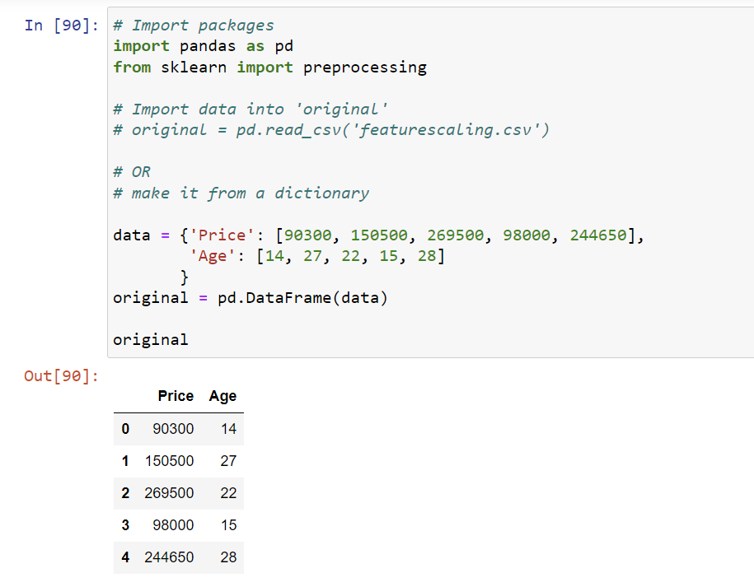
Python Structuring

Slide 56
Cleaning data
Missing data: An unknown or inapplicable value (Income: NaN, None, NULL)
Outlier data: A numeric value that is much larger or smaller than other values in the same feature (Age=1000)
Duplicate data: Duplicate data are two or more identical instances in a dataset
Dirty data: Missing, outlier, and duplicate data are collectively called dirty data
Dirty instance / dirty feature: A dirty instance and a dirty feature contain dirty data
Notes:
https://learn.zybooks.com/zybook/UNTADTA5340OrhanFall2023/chapter/5

Slide 57
What to do with dirty data?
Random assignment!
Discard: Delete row or column
Impute: Replaces missing and outlier data with new and appropriate values
Mean imputation replaces missing and outlier data with the mean value excluding them from the computation of the mean.
Regression imputation / Stochastic regression imputation replaces missing and outlier data with a value computed from a regression model.
dependent variable is the dirty feature and
the independent variables are other features.
Notes:
https://learn.zybooks.com/zybook/UNTADTA5340OrhanFall2023/chapter/5

Slide 58
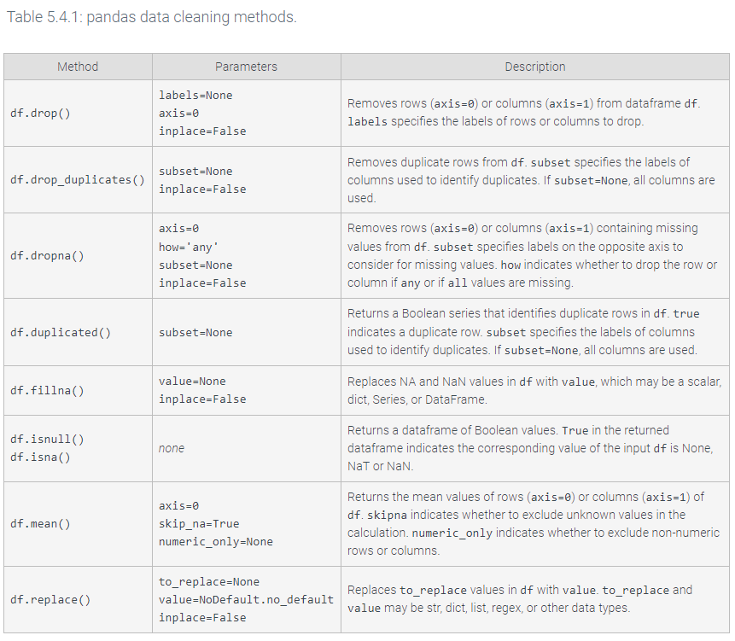
Notes:
https://learn.zybooks.com/zybook/UNTADTA5340OrhanFall2023/chapter/5

Slide 59
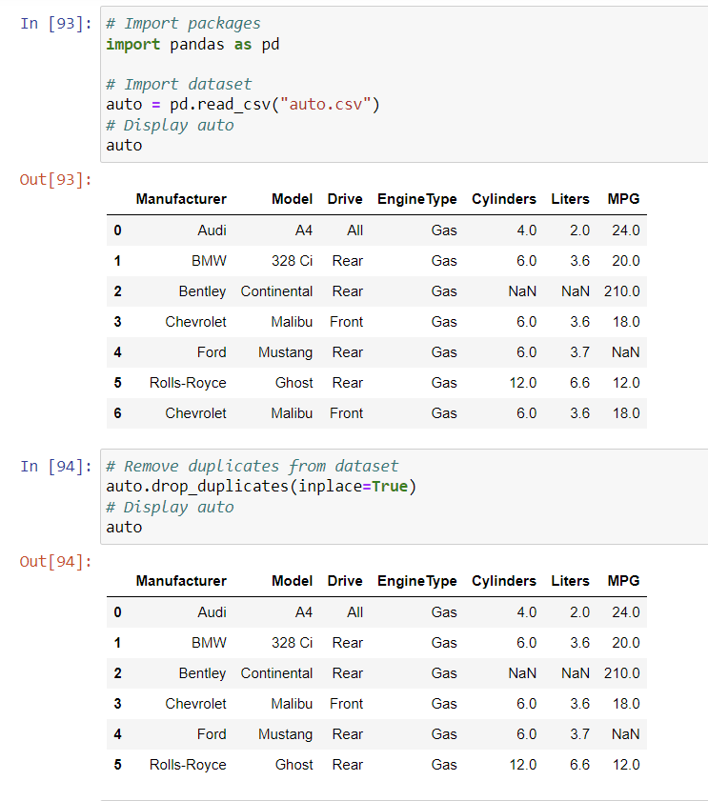
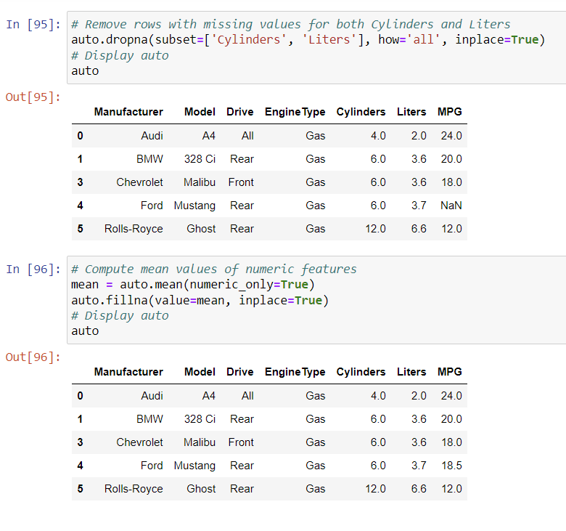

Slide 60
Enriching Data
Append instances or features from other resources How?
Identify the external dataset of interest.
Identify a matching feature in the external and original datasets. The matching feature must uniquely identify instances of both datasets.
Usually, only a subset of the external dataset is of interest. Extract the subset, including the matching feature.
Structure and clean the subset
Be aware of the missing data that may occur due to different features or instances,
impute if required
Derive data from existing features
Calculate from the existing value: size = length x width
Convert values from one type to another

Slide 61
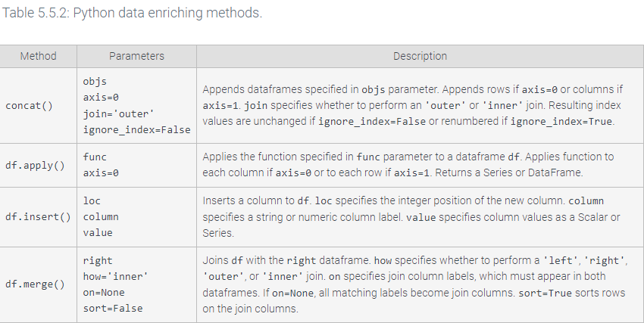

Slide 62
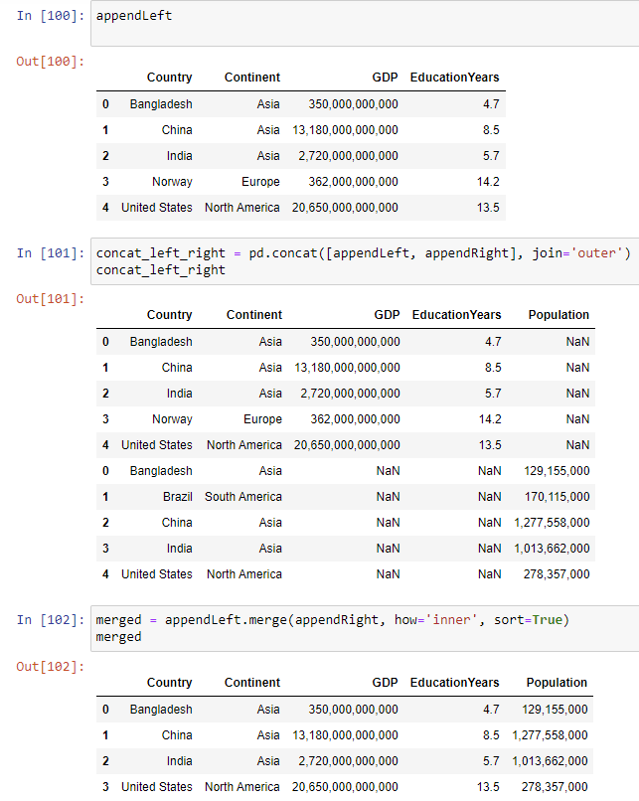
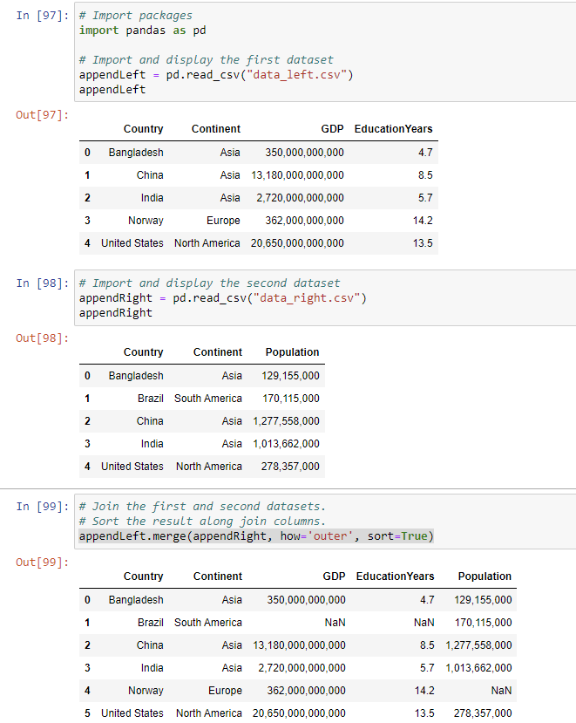

Slide 63
